Slide 1
Codes
9/15/09 - L3 Codes
Copyright 2009 - Joanne DeGroat, ECE, OSU

Slide 2
Class 3 outline
Alphanumeric Codes
  ASCII
  Parity
Gray Codes
Material from sections 1-5 and 1-6 of text
9/15/09 - L3 Codes
Copyright 2009 - Joanne DeGroat, ECE, OSU

Slide 3
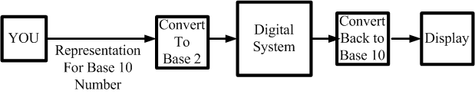
Human perception
We naturally live in a base 10 environment
Computer exist in a base 2 environment
So give the computer/digital system the task of doing the conversions for us.
9/15/09 - L3 Codes
Copyright 2009 - Joanne DeGroat, ECE, OSU

Slide 4
Binary Codes
“An n-bit binary code is a group of n bits that assume up to 2^{n} distinct combinations of 1s and 0s, with each combination representing one element of the set being coded”
For the 10 digits need a 4 bit code. One code is called Binary Coded Decimal (BCD)
9/15/09 - L3 Codes
Copyright 2009 - Joanne DeGroat, ECE, OSU

Slide 5
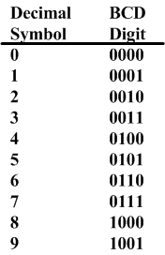
Decimal and BCD
The BCD is simply the 4 bit representation of the decimal digit.
For multiple digit base 10 numbers, each symbol is represented by its BCD digit
What happened to 6 digits not used?
9/15/09 - L3 Codes
Copyright 2009 - Joanne DeGroat, ECE, OSU

Slide 6
BCD operation
Consider the following BCD operation
  Decimal: Add 4 + 1
  Covert to binary 0 1 0 0
  And 0 0 0 1
  Getting 0 1 0 1
  Which is still a BCD representation of a decimal digit
9/15/09 - L3 Codes
Copyright 2009 - Joanne DeGroat, ECE, OSU

Slide 7
Another
A second example
  3 0 0 1 1
  +3 0 0 1 1
  Getting 6 or 0 1 1 0
  And in range and a BCD digit representation
9/15/09 - L3 Codes
Copyright 2009 - Joanne DeGroat, ECE, OSU

Slide 8
And now
Consider 5 + 5
5 0 1 0 1
+5 0 1 0 1
giving 1 0 1 0 which is binary 10 but not a BCD digit!
What to do?
Try adding 6??
9/15/09 - L3 Codes
Copyright 2009 - Joanne DeGroat, ECE, OSU

Slide 9
Adding 6
Had 1010 and want to add 6 or 0110
  so 1 0 1 0
  plus 6 0 1 1 0
  Giving 1 0 0 0 0
Or a carry out to the next binary digit, or if the binary in BCD, the next BCD digit.
9/15/09 - L3 Codes
Copyright 2009 - Joanne DeGroat, ECE, OSU

Slide 10
Another carry example
Add 7 + 6
  have 7 0 1 1 1
  plus 6 0 1 1 0
  Giving 1 1 0 1 and again out of range
  Adding 6 0 1 1 0
  Giving 1 0 0 1 1 so a 1 carries out to the next BCD digit
  FINAL BCD answer 0001 0011 or 13₁₀
9/15/09 - L3 Codes
Copyright 2009 - Joanne DeGroat, ECE, OSU

Slide 11
Multibit BCD
Add the BCD for 417 to 195
Would expect to get 612
  BCD setup - start with Least Significant Digit
  0 1 0 0 0 0 0 1 0 1 1 1
  0 0 0 1 1 0 0 1 0 1 0 1
  1 1 0 0
  Adding 6 0 1 1 0
  Gives 1 0 0 1 0
9/15/09 - L3 Codes
Copyright 2009 - Joanne DeGroat, ECE, OSU

Slide 12
Continuing multibit
Had a carry to the 2nd BCD digit position
  1
  0 1 0 0 0 0 0 1 done
  0 0 0 1 1 0 0 1 0 0 1 0
  1 0 1 1
  Again must add 6 0 1 1 0
  Giving 1 0 0 0 1
  And another carry
9/15/09 - L3 Codes
Copyright 2009 - Joanne DeGroat, ECE, OSU

Slide 13
Still Continuing multibit
Had a carry to the 3rd BCD digit position
  1
  0 1 0 0 done done
  0 0 0 1 0 0 0 1 0 0 1 0
  0 1 1 0
  And answer is 0110 0001 0010 or the BCD for the base 10 number 612
9/15/09 - L3 Codes
Copyright 2009 - Joanne DeGroat, ECE, OSU

Slide 14
Alphanumeric Codes
How do you handle alphanumeric data?
Easy answer!
Formulate a binary code to represent characters! ☺
For the 26 letter of the alphabet would need 5 bit for representation.
But what about the upper case and lower case, and the digits, and special characters
9/15/09 - L3 Codes
Copyright 2009 - Joanne DeGroat, ECE, OSU

Slide 15
A code called ASCII
ASCII stands for American Standard Code for Information Interchange
The code uses 7 bits to encode 128 unique characters
Reference the textbook, pg. 27, for a table of the ASCII code
As a note, formally, work to create this code began in 1960. 1st standard in 1963. Last updated in 1986.
9/15/09 - L3 Codes
Copyright 2009 - Joanne DeGroat, ECE, OSU

Slide 16
ASCII Code
Represents the numbers
  All start 011 xxxx and the xxxx is the BCD for the digit
Represent the characters of the alphabet
  Start with either 100, 101, 110, or 111
  A few special characters are in this area
Start with 010 – space and !”#$%&’()*+.-,/
Start with 000 or 001 – control char like ESC
9/15/09 - L3 Codes
Copyright 2009 - Joanne DeGroat, ECE, OSU

Slide 17
ASCII Example
Encoding of 123
  011 0001 011 0010 011 0011
Encoding of Joanne
  100 1010 110 1111 110 0001
  110 1110 110 1110 110 0101
Note that these are 7 bit codes
9/15/09 - L3 Codes
Copyright 2009 - Joanne DeGroat, ECE, OSU

Slide 18
What to do with the 8th Bit?
In digital systems data is usually organized as bytes or 8 bit of data.
How about using the 8th bit for an error coding. This would help during data transmission, etc.
Parity bit – the extra bit included to make the total number of 1s in the byte either even or odd – called even parity and odd parity
9/15/09 - L3 Codes
Copyright 2009 - Joanne DeGroat, ECE, OSU

Slide 19
Example of Parity
Consider data 100 0001
  Even Parity 0100 0001
  Odd Parity 1100 0001
Consider data 1010100
  Even Parity 1101 0100
  Odd Parity 0101 0100
A parity code can be used for ASCII characters and any binary data.
9/15/09 - L3 Codes
Copyright 2009 - Joanne DeGroat, ECE, OSU

Slide 20
Other Character Codes
Once upon a time, a long, long time ago, there existed cards, called punch cards!
  And a code for those cards called Hollerith code. (patented in 1889)
  The code told you what character was being represented in a column when there was a punch out in various rows of that column.
And another code for characters called EBCDIC (Extended Binary Coded Decimal Interchange Code) (1963, 1964 IBM) - similar to ASCII –
  Digits are coded F0 through F9 in EBCDIC
9/15/09 - L3 Codes
Copyright 2009 - Joanne DeGroat, ECE, OSU

Slide 21
Gray Codes
When you count up or down in binary, the number of bit that change with each digit change varies.
  From 0 to 1 just have a single but
  From 1 to 2 have 2 bits, a 1 to 0 transition and a 0 to 1 transition
  From 7 to 8 have 3 bits changing back to 0 and 1 bit changing to a 1
For some applications multiple bit changes cause significant problems.
9/15/09 - L3 Codes
Copyright 2009 - Joanne DeGroat, ECE, OSU

Slide 22
Gray Code
Contrast of bit changes
  Val Bin Chg Gray Chg
  0 000 000
  1 001 1 001 1
  2 010 2 011 1
  3 011 1 010 1
  4 100 3 110 1
  5 101 1 111 1
  6 110 2 101 1
  7 111 1 100 1
  0 000 3 000 1
9/15/09 - L3 Codes
Copyright 2009 - Joanne DeGroat, ECE, OSU

Slide 23
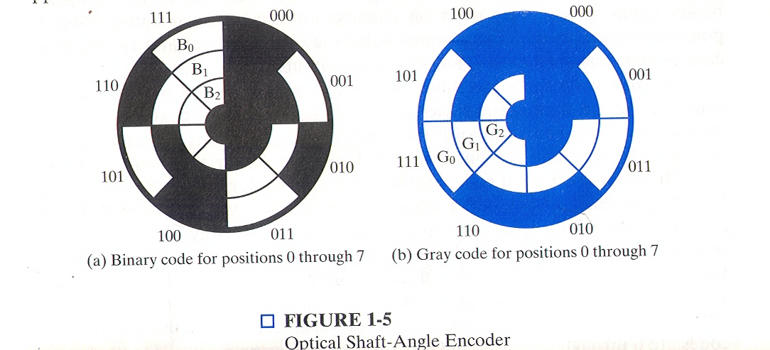
Gray Code Encoder
Copy of figure 1-5 from text
9/15/09 - L3 Codes
Copyright 2009 - Joanne DeGroat, ECE, OSU

Slide 24
Class 3 assignment
Covered sections 1-5 and 1-6
Problems for hand in
  1-22, 1-23
Problems for practice
  1-25, 1-26
Reading for next class: sections 2-1 and 1st 3 pages of 2-2
9/15/09 - L3 Codes
Copyright 2009 - Joanne DeGroat, ECE, OSU

